Slide 1
One day in Taj Hotel by Michel Pollack
Department of English
P.R.Government College (A),
Kakinada

Slide 2
Mumbai terror attack survivor

Slide 3
Michael Pollack
Back in his early 30s, Michael Pollack was your typical finance guy.
“I made a bunch of money,” the now-42-year-old tells The Post. The Upper West Sider enjoyed a cushy, senior-level job at a hedge fund called Glenhill Capital, and remembers himself as a cash-obsessed workaholic: “I was narrowly focused on wealth accumulation.”
But all of that changed after Nov. 26, 2008, when Pollack found himself running for his life during a devastating terror siege in Mumbai, India, at the hands of Pakistani terror group Lashkar-e-Taiba.

Slide 4
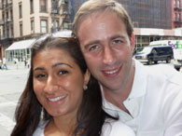
Pollack’s wife, Anjali, grew up in Mumbai, and the couple was in town visiting her family. That Wednesday night, they decided to leave their two young kids with Anjali’s parents, and set off for a date night at the opulent Taj Mahal Palace hotel, where the couple had wed four years earlier

Slide 5
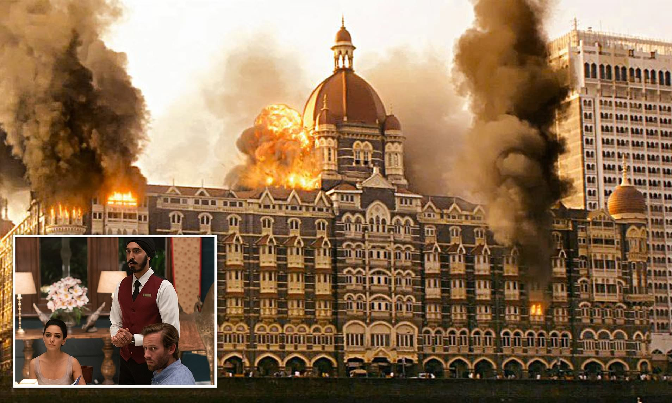
They were sipping pre-dinner drinks at the hotel’s Harbour Bar at when gunshots rang out. Four men with AK-47s had just stormed into the hotel.
Terrified, the Pollacks tried, unsuccessfully, to smash the bar’s windows to escape onto the streets. They were rescued by hotel staffers, who quickly ushered them into the kitchen and barricaded the door — as the shooters tried to break it down.

Slide 6
“They were literally less than a foot from me with the rifle butts trying to break through the door,” says Pollack.

Slide 7
More lives were lost during the next several hours of the attack, which Pollack describes as a “mad scramble.” At one point, he and his wife split up, because they were terrified that they would die together, leaving their kids orphaned. Pollack remembers holding a hotel staffer who was shot in the stomach, and carrying him down a stairwell as he died.

Slide 8
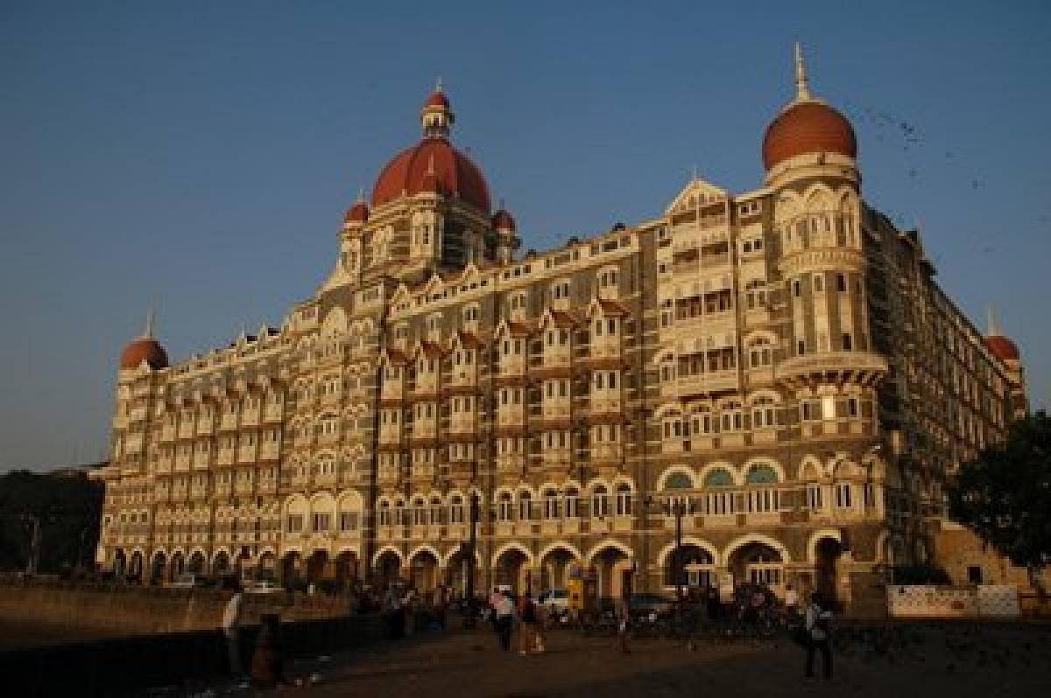
Few Pictures related to Mumbai Attacks

Slide 9
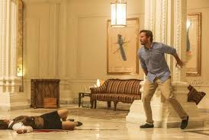
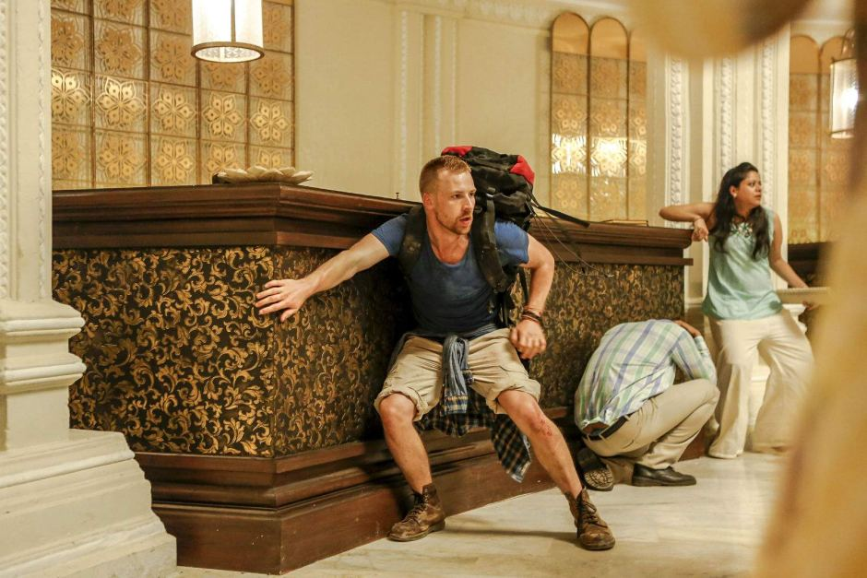

Slide 10
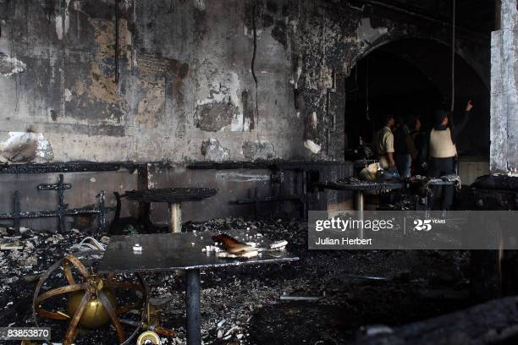
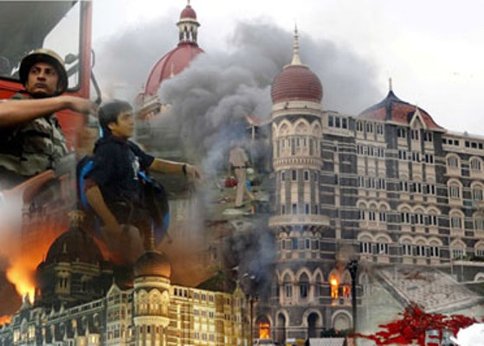

Slide 11
Events Of November 26–29
The attacks were carried out by 10 gunmen who were believed to be connected to Lashkar-e-Taiba, a Pakistan-based terrorist organization. Armed with automatic weapons and hand grenades, the terrorists targeted civilians at numerous sites in the southern part of Mumbai, including the Chhatrapati Shivaji railway station, the popular Leopold Café, two hospitals, and a theatre. While most of the attacks ended within a few hours after they began at around 9:30 PM on November 26, the terror continued to unfold at three locations where hostages were taken—the Nariman House, where a Jewish outreach centre was located, and the luxury hotels Oberoi Trident and Taj Mahal Palace & Tower.

Slide 12
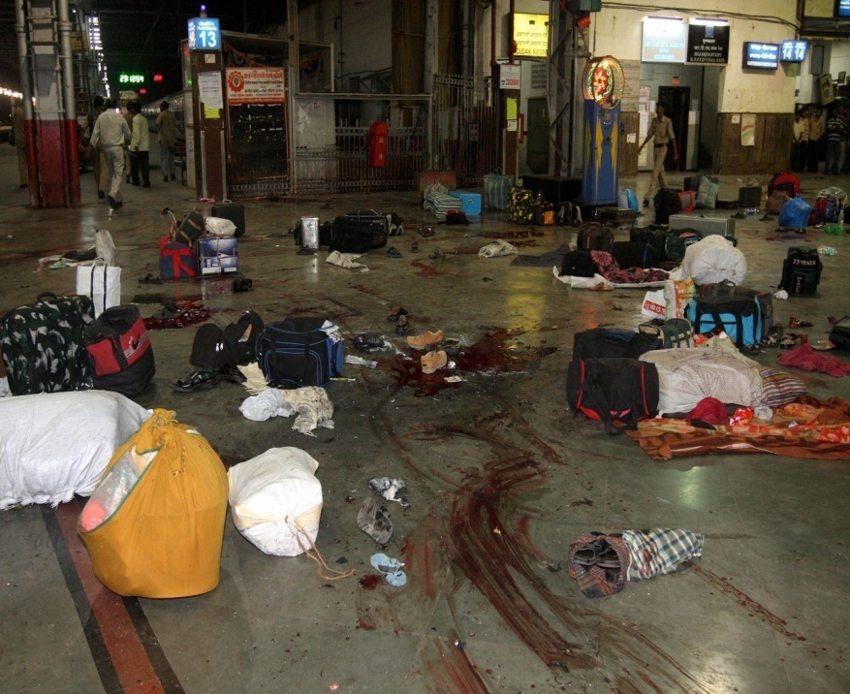
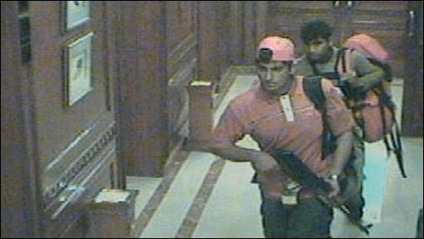

Slide 13
Ten Pakistani men associated with the terror group Lashkar-e-Tayyiba stormed buildings in Mumbai, killing 164 people. Nine of the gunmen were killed during the attacks, one survived. Mohammed Ajmal Kasab, the lone surviving gunman, was executed in November 2012.
They traveled from Karachi, Pakistan, to Mumbai via boat. Along the way, they hijacked a fishing trawler and killed four crew members, throwing their bodies overboard. They also slit the captain's throat.
The terrorists docked at the Mumbai waterfront near the Gateway of India monument. They hijacked cars, including a police van, and split into at least three groups to carry out the attacks, according to police. The attackers used automatic weapons and grenades.

Slide 14
